Slide 1
Mindful Communication: Inclusive Language, Open Mindset Talk with the confidence, listen with openness: your greatest asset is believing in yourself + recognizing the potential in those around you.
Founder | Professor | Scholar
Dr. Clara Fangfang Ma

Slide 2

Relevance in Business Communication
In 2020, the global market for DEI—that is, dollars spent by companies on DEI-related efforts such as employee resource groups (ERGs)—was estimated at $7.5 billion and is projected to more than double to $15.4 billion by 2026.
Notes:
DEIB in global business communication stands for Diversity, Equity, Inclusion, and Belonging. These elements not only enhance decision-making and expand market understanding but also build a positive corporate reputation and ensure compliance with global standards, crucial for successful global business interactions.

Slide 3
Cultural Awareness and Empathy in Communication
Why? (Kahoot)

Slide 4
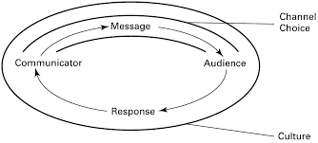
Culture bounds our communication strategy
Source: Munter, M. & Hamilton, L. (2014). Guide to managerial Communication

Slide 5
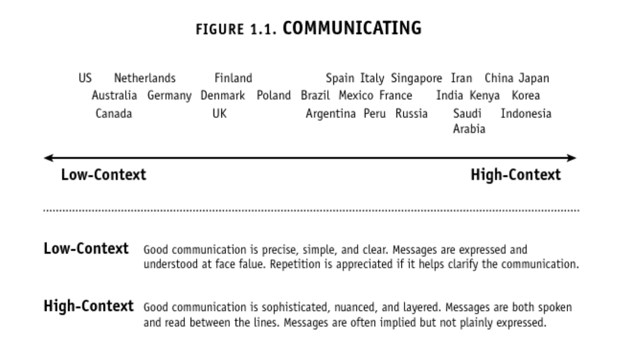
Low-Context vs. High-Context?
Source: Erin Meyer, The Culture Map
Notes:
Erin Meyer, an expert on intercultural communication at INSEAD, produced some very interesting charts in her fabulous book, The Culture Map, showing where each country falls on a scale of preference for direct versus indirect speech. Interestingly, she refers to the difference as “low context” versus “high context”. Of course, not everyone from each of these countries fall on the exact space on this continuum. Don’t think of this as a map of individual personalities based on their nationality. Instead, think of each point on the scale as representing the type of communication most valued in business and higher-education contexts in each country.
Context also tends to correlate with formality, because you can think of formality as conventions for acknowledging the context of the person’s position in society. When I moved to the U.K., I made the mistake of addressing someone I didn’t know at the university where I was about to begin a graduate degree, by their first name — like a good American, I was direct and informal. I was corrected explicitly in that instance, perhaps because the Brits are still fairly left on the low-context side of the scale. Then, when I later moved to South Korea, I found once again that first names were rarely used. However, this time it was because of a different convention. The Korean female teachers at the school where I worked preferred that I call them ”big sister” (“eonni”) a term that simultaneously acknowledged our close working relationship, and their mentoring role towards me as the junior teacher on staff.
As you can see, Meyer maps the U.S. as the lowest-context culture, and she points to our long history of immigration as a reason. People with very little in common need to provide all of the context for their meaning up front with their message. She also provides this very amusing table, which explains the difference between communicating in a low-context (Netherlands) and higher-context (UK) countries:

Slide 6
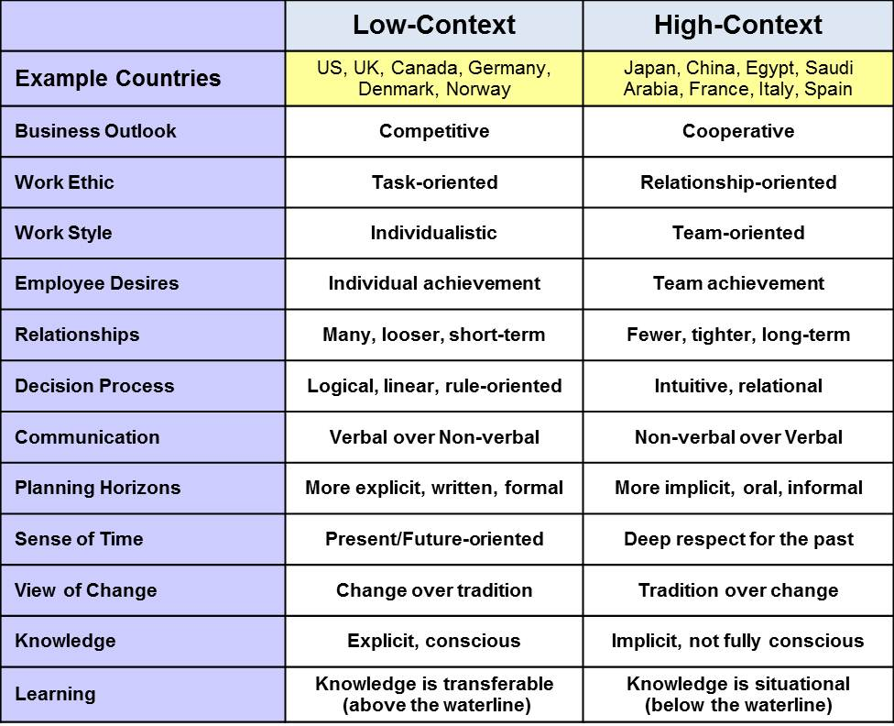

Slide 7
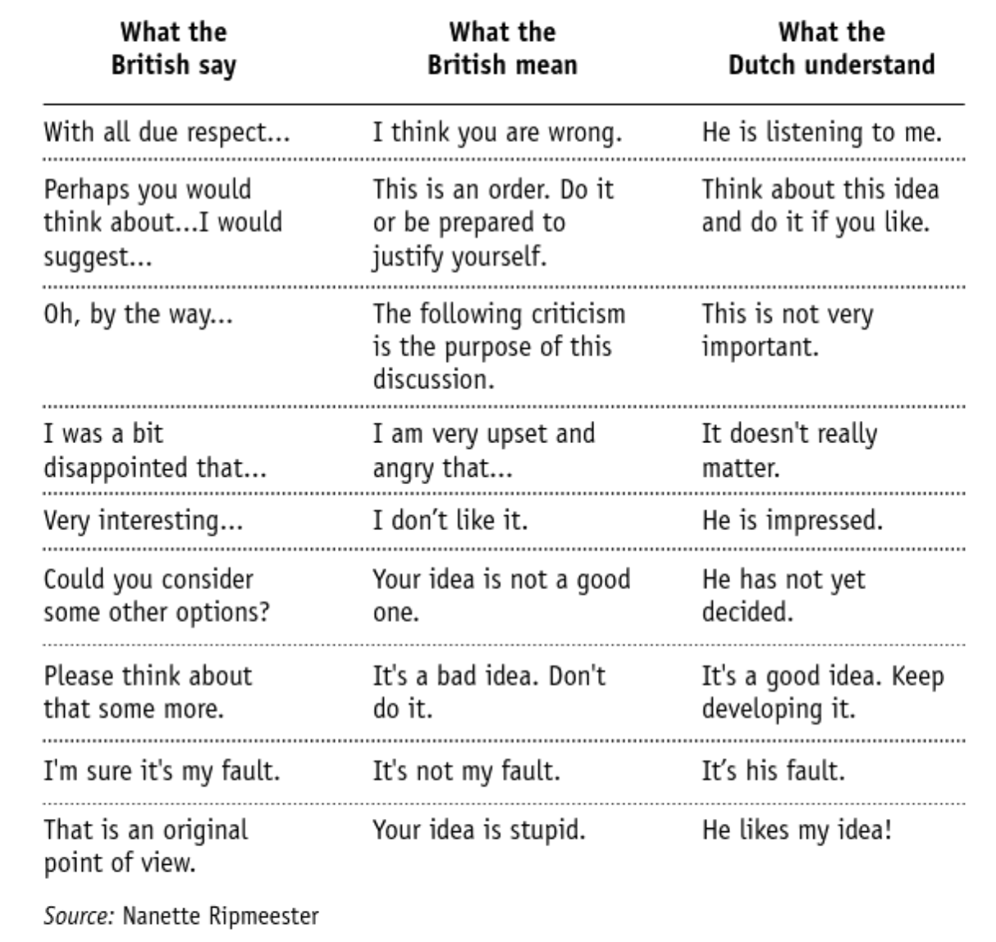
INDIRECT
DIRECT
Notes:
The British are masters of polite understatement, and this chart highlights the more humorous instances when British business-speak that would be misinterpreted by a lower-context culture like the Dutch. This chart shows how in Britain, you need to get the subtext in addition to reading the text. As you read this, keep in mind that the British are still a relatively low-context communication culture.
Here, you can see exactly how context – in this case cultural – affects the interpretation of the original words. You can also see that context is so powerful a force on a message that it sometimes reverses the meaning of the original words. (I’m sure it’s my fault)

Slide 8
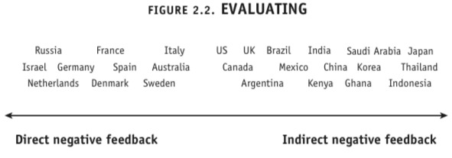
…But disagreement is another matter
Source: Erin Meyer, The Culture Map

Slide 9
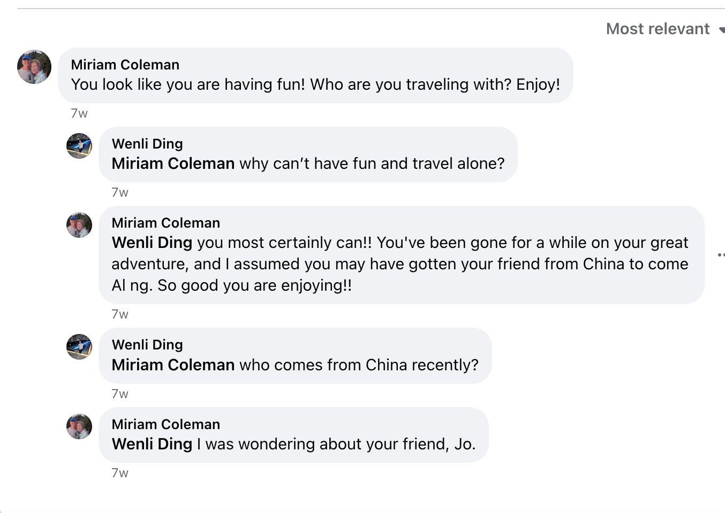

Slide 10
…But disagreement is another matter
Source: Erin Meyer, The Culture Map

Slide 11
American cultural-communication values?
Low-context / direct
This is especially true in writing, less so orally.
Except when giving negative feedback
Individualistic – what about me?
Active voice – our voice should be heard
Positive – historical reasons as well
Multicultural – melting pot
Tolerant - depends
Notes:
And why?

Slide 12
Reflection: Your “home” communication values - Slido
Can you recall a situation where you experienced a possible misunderstanding due to cultural barrier?
Think about your own communication style to your teammates. Do you naturally lean towards high-context or low-context communication? Give an example.
How could misinterpretations be minimized when someone from a low-context culture presents to an audience from a high-context culture?

Slide 13
Which kind of communication do you prefer?
High or low context? (Kahoot)

Slide 14
Inclusive Language and Overcoming Language Barriers
Avoid assumptions, stereotypes, and culturally insensitive expressions.
Choose words that respect and acknowledge diversity.
Speak clearly, avoiding idioms and colloquialisms.
Open to questions for clarity.
Use visual aids or written summaries (follow up) to support communication.

Slide 15
Inclusive Language and Overcoming Language Barriers
Subject: Project Deadline Approaching
Hello Rajesh,
I hope you're doing well. I'm writing to remind you about the project deadline next week. It's important that we find creative solutions soon. Please ensure you are up to date with your tasks and let me know if you need any help.
Best regards,
Sarah
Subject: Project Deadline Approaching
Hi Rajesh,
I wanted to touch base with you regarding the upcoming project deadline. We're down to the wire, so let’s try to think outside the box for innovative solutions. Make sure you’re on the ball with your tasks.
Regards,
Sarah

Slide 16
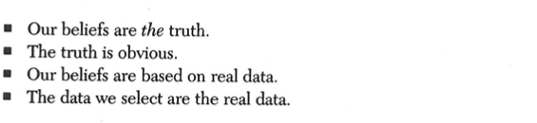
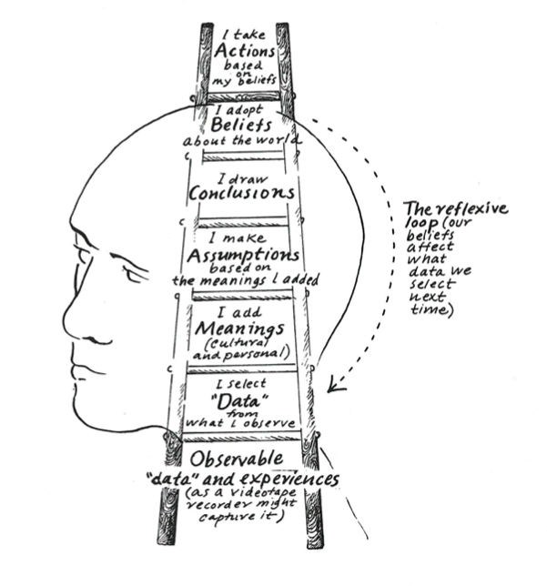
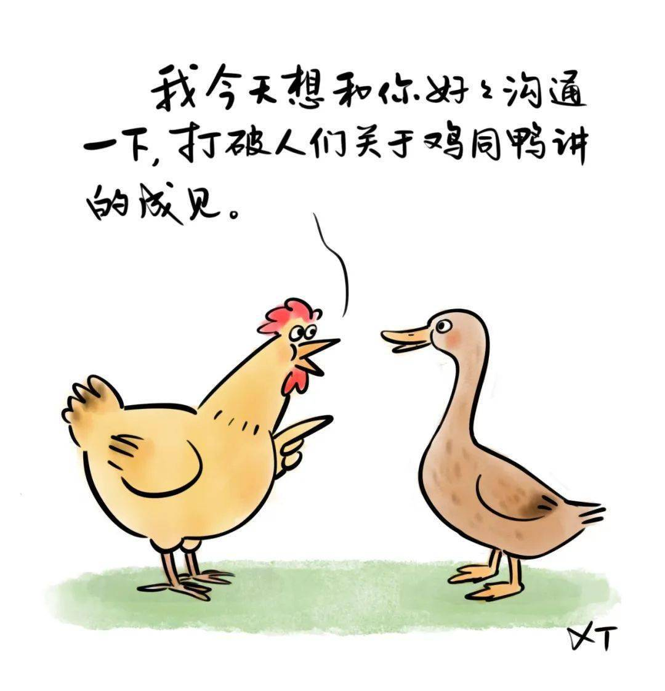

Slide 17
Conflict Resolution in Multicultural Environments
Recognize and respect differences in the team.
Active listening.
Focus on common goals.
Seek external mediation.

Slide 18
Building Inclusive Teams and Networking – What does it look like to you?
Foster an atmosphere of respect and inclusion.
Recognize and celebrate cultural differences.
Build networks with diverse groups for broader insights.

Slide 19
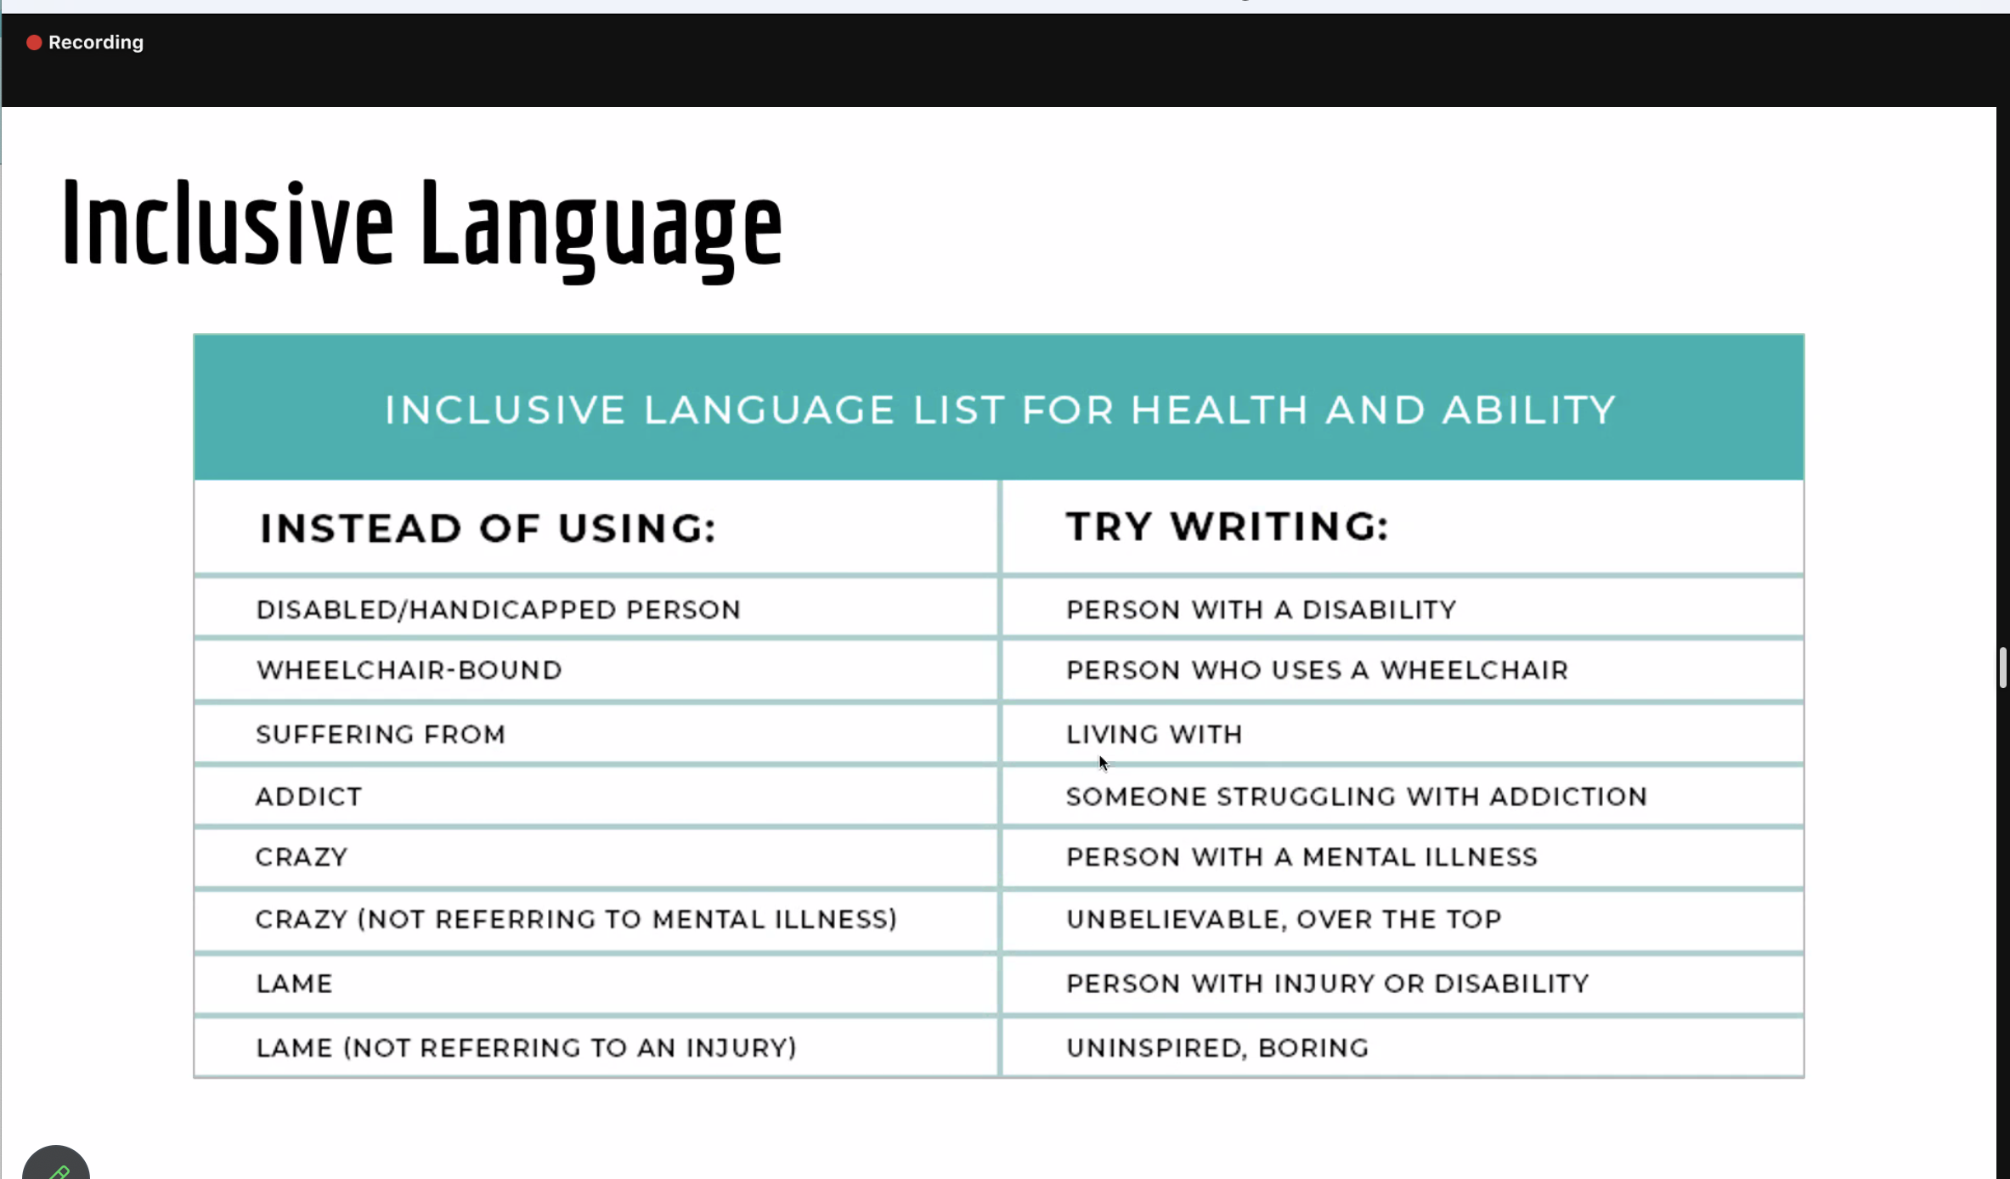

Slide 20
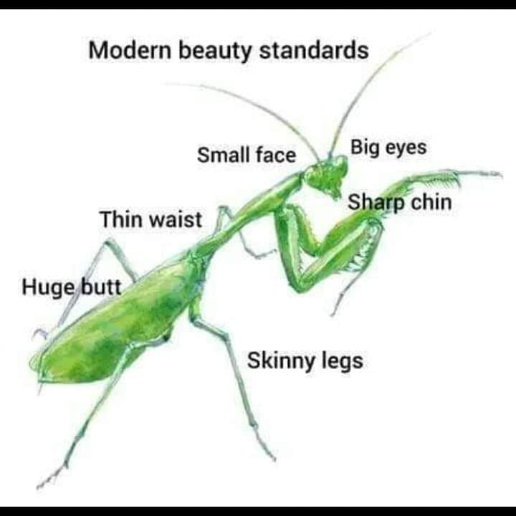
1, Body size and weight 2, Disability 3, Neurodivergent 4, Race, ethnicity, and culture 5, Socioeconomic status https://www.apa.org/about/apa/equity-diversity-inclusion/language-guidelines

Slide 21
Confidence in your voice opens doors, but empathy in your listening builds bridges. Talk as if your ideas can change the world, and listen as if others’ ideas can enhance yours.

Slide 22
In finance, your ambition drives you forward, but your humility keeps you grounded.

